Slide 1
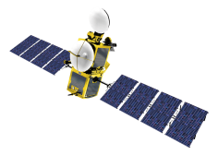
Update on
User service activities
GEO Visit
2 July 2015

Slide 2
New User Notification Service (UNS)
Launched on 28 May 2015

Slide 3
New User Notification Service (UNS)
Parallel operations phase with the old UNS until 9 July 2015.
UNS messages via EUMETCast now sent in xml format, in addition to the txt format.
After 9 July:
The old UNS will no longer be available and user subscriptions to the old UNS will expire.
UNS messages sent via EUMETCast in txt format will be discontinued.
We welcome any feedback you may have.

Slide 4
Web Map Services (WMS)
This is a new service to visualise EUMETSAT satellite data.
It is intended to replace the existing web imagery service.
Release of WMS open pilot for essential data imagery planned for 8 July 2015.
The service makes use of the OGC Web Map Service specification, which allows users to see satellite imagery in a standard, interoperable way.

Slide 5
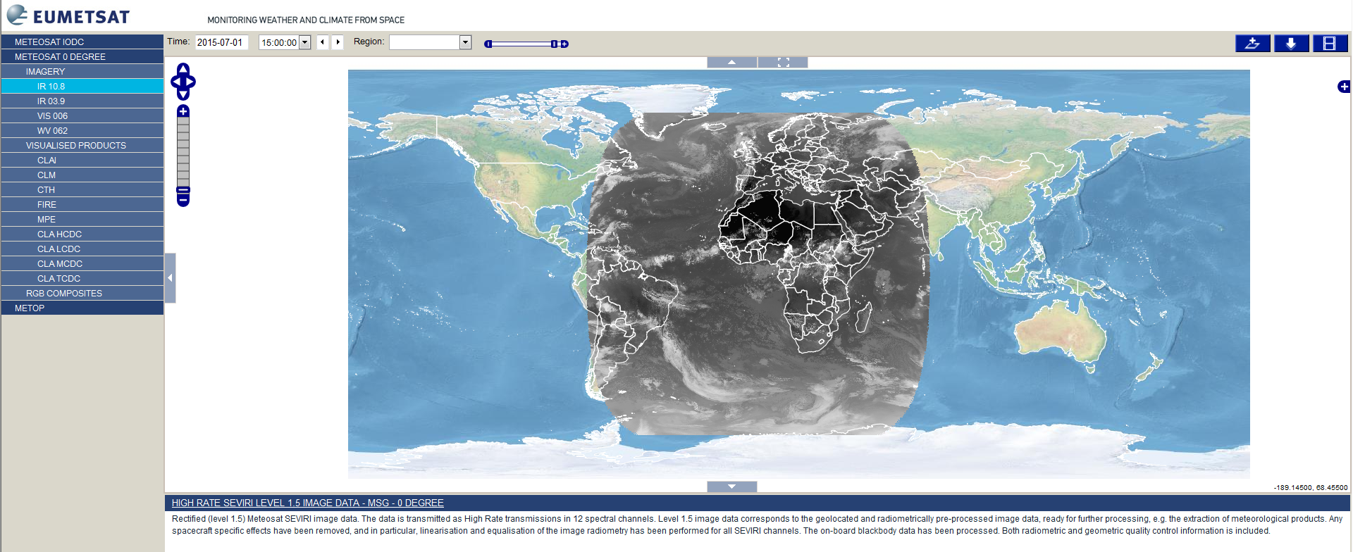
Web Map Services (WMS)
Key features of the WMS
Provides a simple view of EUMETSAT’s satellite products
Allows easy regional selection, overlay of products on World Map background
Imagery available in various formats
OGC standards allow for easy exchange of imagery between web map viewer providers

Slide 6
Web Map Services (WMS)
Additional features being considered:
Longer archive of imagery (full archive for 3 months, selected imagery for longer periods)
FTP service to support image download.

Slide 7
Thank you !

